Slide 1
Big Mountain Resort
Analysis Presentation
Ryan Mennemeier

Slide 2
Problem Statement Overview
What avenues exist for Big Mountain Resort to either:
Cut costs without changing current pricing model
Increase ticket pricing to their customers while maintaining value of their overall product?

Slide 3
Recommendation
After our analysis we recommend that Big Mountain Resort:
Add an additional Run
Increase the Vertical Drop by 150 ft
Install an additional chair lift
In doing so we can support an increase in overall ticket price increase of $1.99/tkt, combined with the expected visitors (350k) to show an estimated increased revenue of $3.5M.

Slide 4
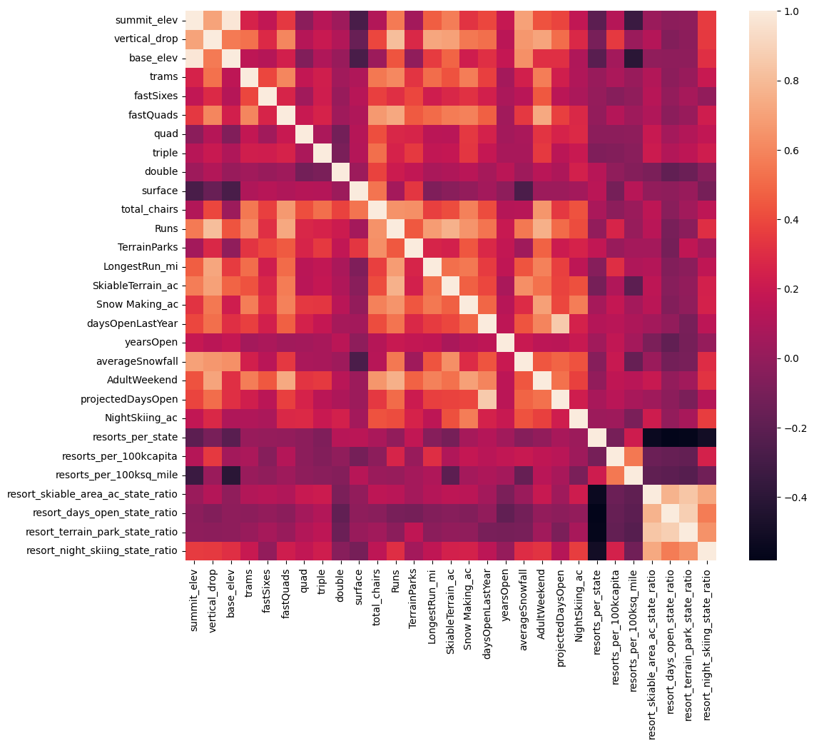
Analysis Results and Findings
As the data provided was filtered, we
started to see relationships between
key features associated in the data.
We then conducted further
analyses using subgroups of these
target features against ticket pricing.
The most important features we used being:
fastQuads
Runs
Snow Making_ac
vertical_drop

Slide 5
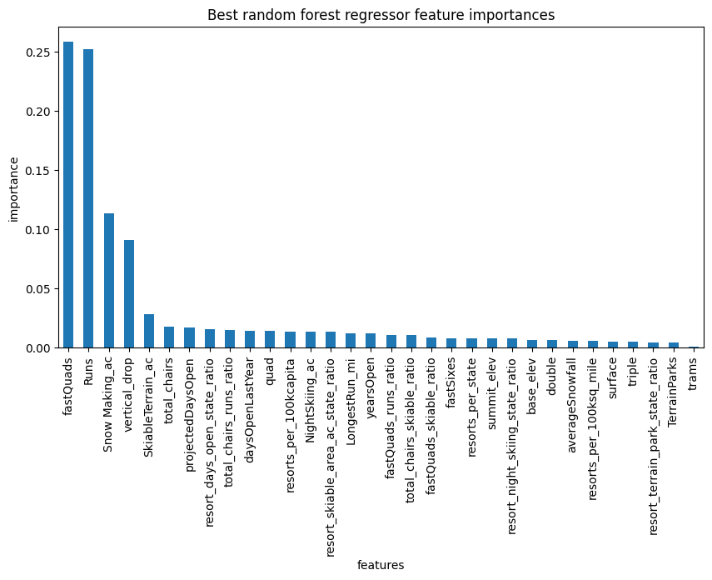
Further Analysis
Using previous findings we then performed
modeling tests on the new datasets and
showed that now fastQuads and Runs are
the optimal features that correlate with
our ticket pricing key feature.

Slide 6
Scenario Performance and Review
We were able to conduct 4 plausible scenarios to solve our key problem statement.
Of these 4 scenarios two of them had no definitive outcome, while one other had no effect or a potentially negative one depending on how many Runs were closed.
The scenario chosen showed positive results and stayed within our margin of error, thus why it is our Recommended scenario.

Slide 7
Summary and Conclusion
It is with confidence that we can conclude the following:
Even with the data provided we stand by the Recommended results
However:
Should more data be acquired this could yield optimized results as well as any additional queries.

Slide 8
THANK YOU!

